Slide 1
Neuroergonomics
IE 590 – Applied Ergonomics
Fall 2016
Team Members: Aziza Ashkanani, Gayatri Devi Mandava, Rajiv Rai, and Wenqui Wang
December 6, 2016

Slide 2
Introduction
Moore's law 1965 - This law renders last year's laptop models defunct, and it will undoubtedly make next year's tech devices breathtakingly small and fast compared to today's.
In 1951 Alan Turing said "Once the machine thinking method has started, it would not take long to outstrip our feeble powers.
Physicists Lawrence Krauss and Glenn Starkman indicate that computer will encompass the universe, turning every bit of matter and energy into a part of its circuit, in 600 years' time.
In an effort to avoid this inauspicious outcome and, in turn, realize the human potential, the nature of human–system couplings is evolving.

Slide 3
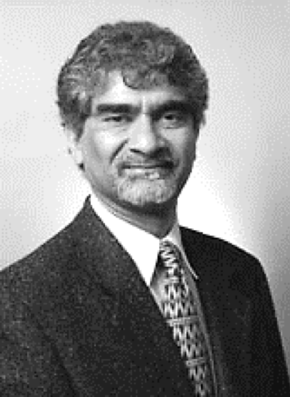
Neuroscience + Ergonomics
“The goal of merging these two fields is to use the startling discoveries of human brain and physiological functioning both to inform the design of technologies in the workplace and home, and to provide new training methods that enhance performance, expand capabilities, and optimize the fit between people and technology.”
The book ‘The Brain at Work’ by Raja Parasuraman and Matthew Rizzo
Neuro-ergonomics has two major goals:
to use existing and emerging knowledge of human performance and brain function to design technologies and work environments for safer and more efficient operation;
to advance understanding of brain function in relation to human performance in real-world tasks
Dr.R.Parasuraman
Father of Neuro-ergonomics

Slide 4
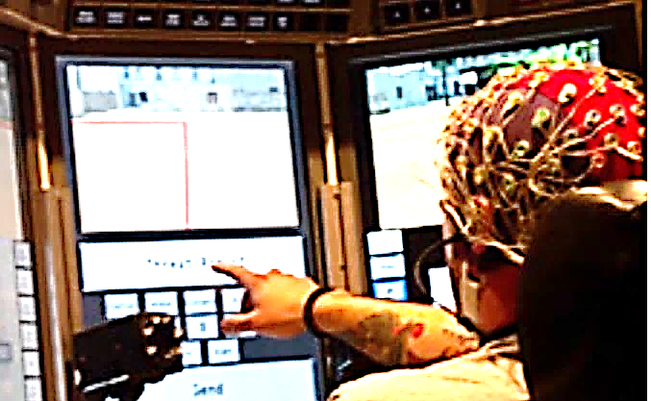
Various aspects of human behaviour in relation to technology and work, include–
mental workload
visual attention
working memory
motor control
human - automation interaction
adaptive automation
Image courtesy of NIRX optical neuroimaging

Slide 5
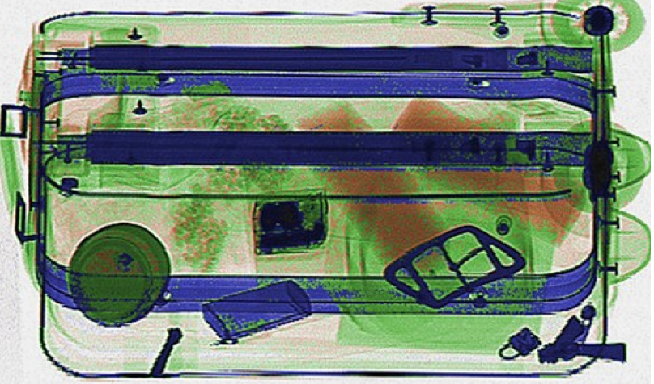
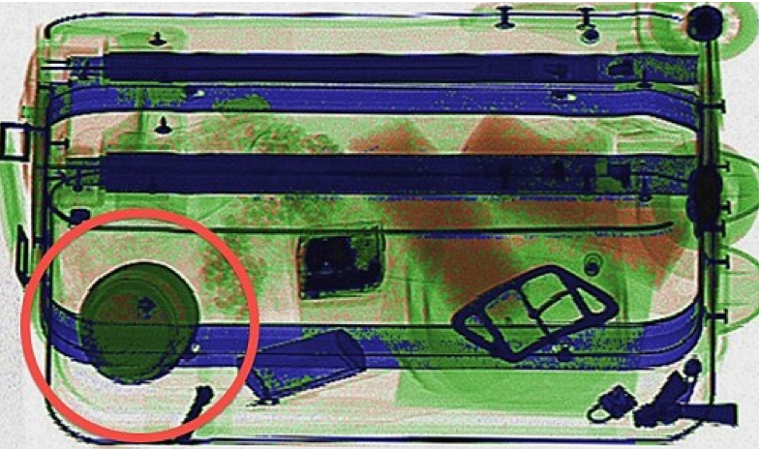
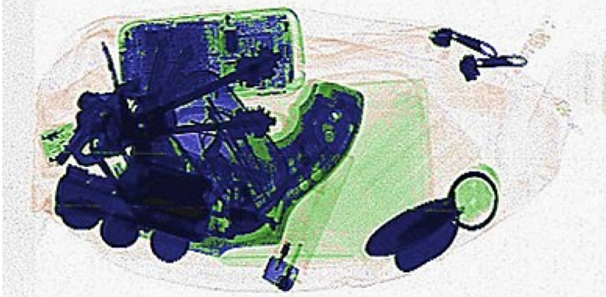
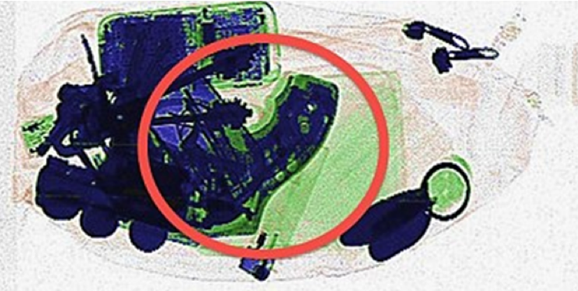
Example
Identify the contraband item in the X Ray images of the following luggage items (in 3 sec)
Bottle of cream > 100mL
0.44 Calibre colt

Slide 6
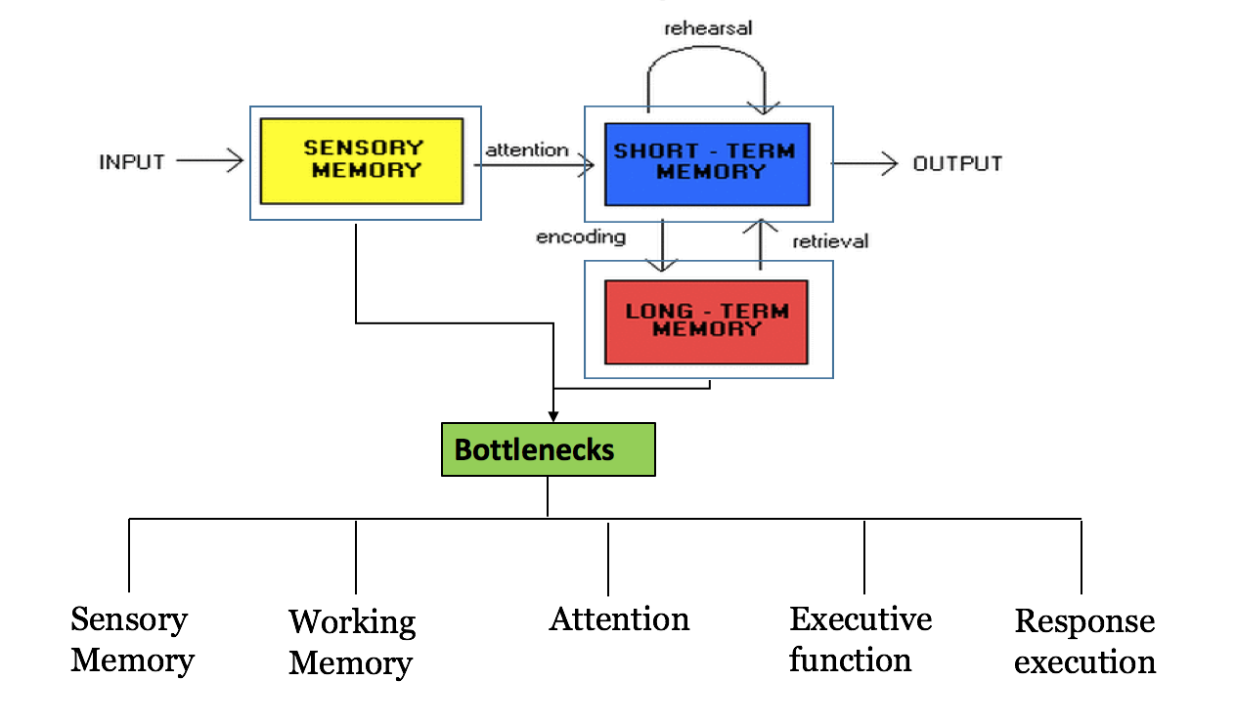
WHY Neuro-ergonomics

Slide 7
Bottlenecks to Human Information Processing
Sensory Memory- a. visual iconic sensory = capacity 17 items
b. audition, or echoic = capacity 05 items
c. haptic = capacity 02 items
d. olfactory and gustatory = unknown
2. Working Memory
capacity of about seven chunks, a rapid decay rate of about 200 ms, and a recognize–act processing time of 70 ms.
3. Attention
critical information is lost due to overload of incoming information, stimulus competition, or distractions.
4. Executive function
more frequent switching may entail greater contextual changes, it is expected to engage effortful EF processing.
5. Response Execution
performance deteriorates during multi-tasking and high-workload task conditions.

Slide 8
features
A core feature of neuro-ergonomics is an interest in brain mechanisms in relation to human performance at work

Slide 9
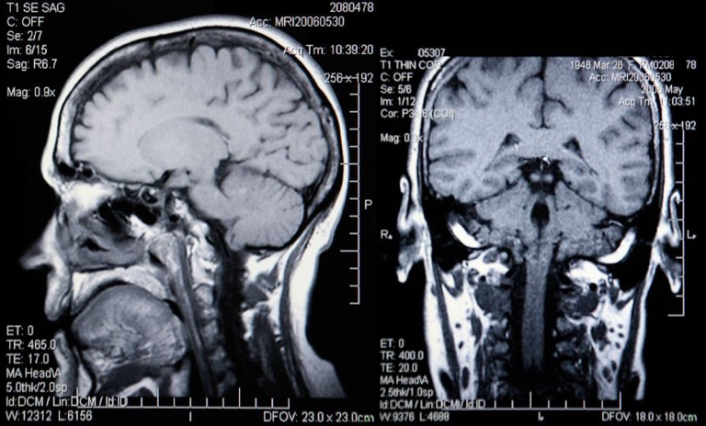
How to measure?

Slide 10
Methods
The most direct of such measures are those derived from the brain itself, as in the
Electroencephalogram (EEG)
Magneto-encephalogaphy (MEG) and
Event-related brain potentials (ERPs)
In addition to these electromagnetic measurements, measures of the brain’s metabolic and vascular responses, e.g.
positron emission tomography (PET) and
functional magnetic resonance imaging (fMRI)

Slide 11
Methods (cont’d)
The three most common and most frequently used measures are
functional Magnetic Resonance Imaging (fMRI),
magnetoencephalography (MEG) and
electroencephalography (EEG).
Of these methods, EEG is the most versatile and cost efficient solution.

Slide 12
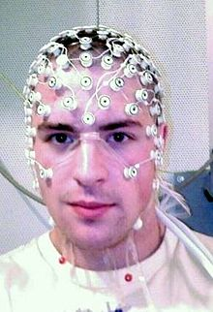
Methods (cont’d)
I. Electroencephalography (EEG)
It is an electrophysiological monitoring method to record electrical activity of the brain. It is typically noninvasive, with the electrodes placed along the scalp
EEG measures voltage fluctuations resulting from ionic current within the neurons of the brain.
Diagnostic applications generally focus on the spectral content of EEG, that is, the type of neural oscillations (popularly called "brain waves") that can be observed in EEG signals.

Slide 13
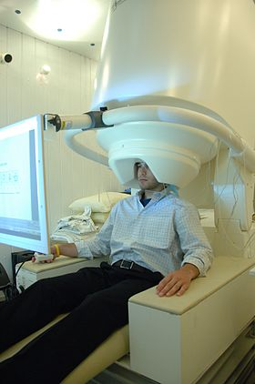
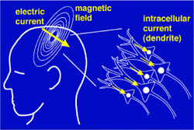
Methods (cont’d)
II. Magnetoencephalography (MEG):
While EEG is recording the electrical activity generated by neural firing, MEG captures the magnetic fields generated by neural activity. MEG devices are completely stationary (similar to fMRI devices). They require the participant to lay or sit almost motionless and keep movements to a minimum.
The biggest advantage is that MEG combines the high precision in time of the EEG with the high precision in space of the fMRI. You can know exactly which areas are active and at the same time you will know the structure of the skull and the brain very precisely.

Slide 14
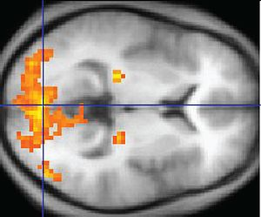
Methods (cont’d)
III. Functional Magnetic Resonance Imaging (fMRI):
fMRI is a functional neuroimaging procedure measuring brain function by detecting changes in blood flow associated with neural activity. The assumption is that neurons need more oxygen when they’re active. Because blood flow is slow, fMRI is known to have low time resolution. However, the central strength of magnetic resonance imaging is its excellent spatial resolution.
Typically, respondents have to lay motionless in a magnetic core while a superconducting magnet is rotating with high frequency around the body. fMRI then measures the change in magnetization between oxygen-rich and oxygen-poor blood.
With magnetic imaging you can reconstruct the individual skull shapes and cortical layers of all of your respondents.

Slide 15
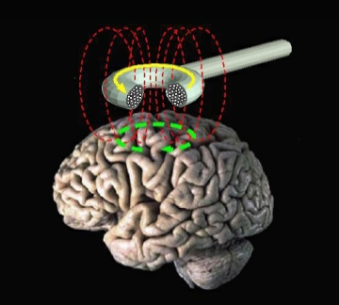
Methods (cont’d)
IV. Transcranial-magnetic stimulation (TMS) is a magnetic method used to stimulate small regions of the brain. During a TMS procedure, a magnetic field generator, or "coil", is placed near the head of the person receiving the treatment. The coil produces small electric currents in the region of the brain just under the coil via electromagnetic induction. The coil is connected to a pulse generator, or stimulator, that delivers electric current to the coil.
Transcranial magnetic stimulation (schematic diagram)

Slide 16
Applications - Driving Safety
http://www.spring.org.uk/images/brain32.jpg
Neuro-ergonomics → neuroscience, human factors, cognitive psychology, and ergonomics
Neuro-ergonomics can be applied to gain greater understanding of human behavior and performance in a wide range of settings at home, at work, and traveling in between.
Lees, M. N., Cosman, J. D., Lee, J. D., Rizzo, M., & Fricke, N. (2010). Translating cognitive neuroscience to the driver’s operational environment: a neuroergonomics approach. The American journal of psychology, 123(4), 391.

Slide 17
Driving Safety (cont’d)
Driving safety of older drivers with cognitive impairments is a potential application domain for neuro-ergonomics.
Driving makes demands on multiple cognitive processes.
Neurology and cognitive sciences help explain the mechanisms of cognitive breakdowns.
https://thepsychologist.bps.org.uk/sites/thepsychologist.bps.org.uk/files/spence_0.jpg
Tools to explore various layers of complexity related to the activity of driving.
Variety of tools can be used to provide an array of potential interventions to increase driving safety
Examples: part task simulators, driving simulators, and instrumented vehicles
Lees, M. N., Cosman, J. D., Lee, J. D., Rizzo, M., & Fricke, N. (2010). Translating cognitive neuroscience to the driver’s operational environment: a neuroergonomics approach. The American journal of psychology, 123(4), 391.

Slide 18
Neurocognitive disabilities
Neuro-ergonomic assessments have great potential for evaluating the psychomotor performance in an individual with a neurocognitive disability or following a stroke or surgery.
Those assessments allow for a standardized method for measuring the change in neurocognitive function during rehabilitation.
http://www.frontiersin.org/files/Articles/186120/fnhum-10-00220-HTML/image_m/fnhum-10-00220-g002.jpg
One feature of the brain → ability to adapt to changing environments.
Maintained throughout the life and is involved in the recovery phase of an injury
Moller, H. J., & Mikulis, D. J. (2007). Neurocognitive disability, stroke, and surgery: A role for neuroergonomics?. Journal of psychosomatic research, 63(6), 613-615.

Slide 19
Neurocognitive disabilities (cont’d)
Reliable tests of neurocognitive functions (e.g. driving, meal preparation, etc.) would be desirable to both patients and clinicians
Patients undergoing operative procedures (neurosurgery)
Pre- and post-operative psychometric testing would allow clinicians to better understand “real-world” patient functions affected by disease.
Neuro-ergonomics assessments would offer the potential for rehabilitating the stroke-related disabilities.
The analysis of neural network patterns visualized with functional brain maps could detect adaptive signatures that would optimize rehabilitation strategies.
http://www.extremetech.com/wp-content/uploads/2015/07/neural-net-head.jpg
http://www.sciencecare.com/wp-content/uploads/2016/05/Stroke-rehabilitation.jpg
Moller, H. J., & Mikulis, D. J. (2007). Neurocognitive disability, stroke, and surgery: A role for neuroergonomics?. Journal of psychosomatic research, 63(6), 613-615.

Slide 20
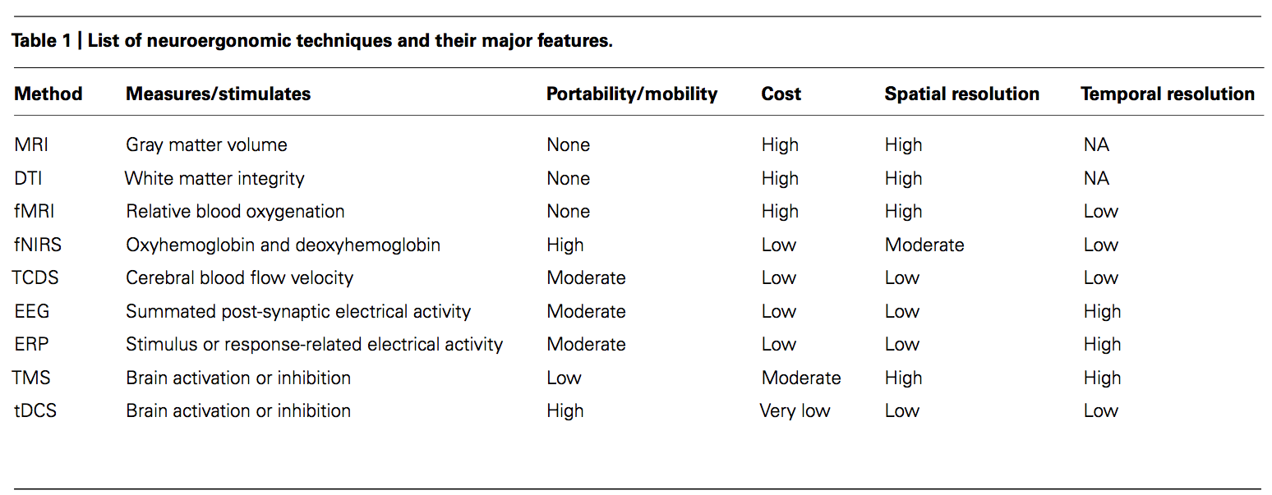
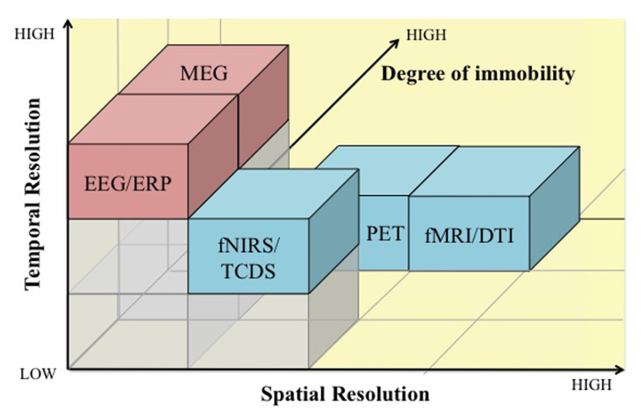
Brain Activity measurement
Physiological Measures, such as cardiovascular (e.g. heart rate), ocular (e.g. eye movement), and brain activity.
Electromagnetic measurements | Metabolic measurements
Electroencephalogram, Magneto-encephalogaphy(MEG) | Positron Emission Tomography (PET), functional Magnetic Resonance Imaging(fMRI)
Front. Hum. Neurosci., 23 December 2013

Slide 21
Neuro-ergonomics applications
Human Error
Learning and skill acquisition
Other applications, e.g. developing ‘neuro-erogonomic aids’ for the physically incapacitated, understanding spatial navigation, and etc.

Slide 22
Human Errors
Analysis of brain activity associated with errors can help lead to testable hypotheses concerning the elicitation of error.
Many different approaches have been proposed to the classification, description and explanation of human error in complex human-machine systems.
In the literature, researcher discover that whenever an individual commits a n error, a specific event related potential (ERP) component associated with errors has been identified, the error-related negativity (ERN).

Slide 23
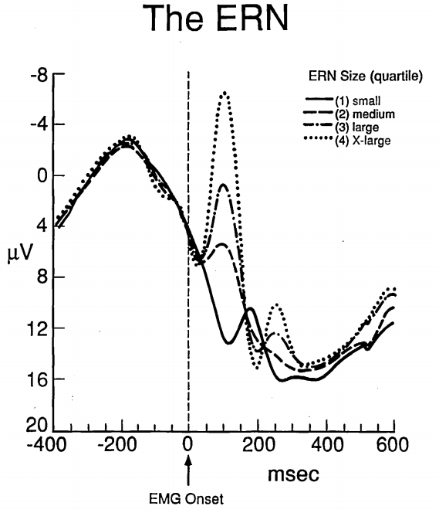
Human Errors (cont’d)
Response to letters in a string by either left hand or left had
HHHHH
SSSSS
HHSHH
SSHSS
A system could be activated by an ERN detector could be helpful in
taking control of the situation
notifying the operator about the error committed
Providing an adaptive interface which selectively presents the critical sub-system or function
In another word, keeping the operator in control of the system while providing an anchor for troubleshooting when the error happens.
Psychological Science November 1993vol. 4 no. 6 385-390

Slide 24
Learning and skill acquisition
Learning represents an area that is particular suitable to neuro-ergonomics since the associated brain functional changes that occur can now be monitored.
Procedure learning is thought to progress through a series of stages, and understanding the brain changes that accompany stages of learning could lead to the development of better training procedures.

Slide 25
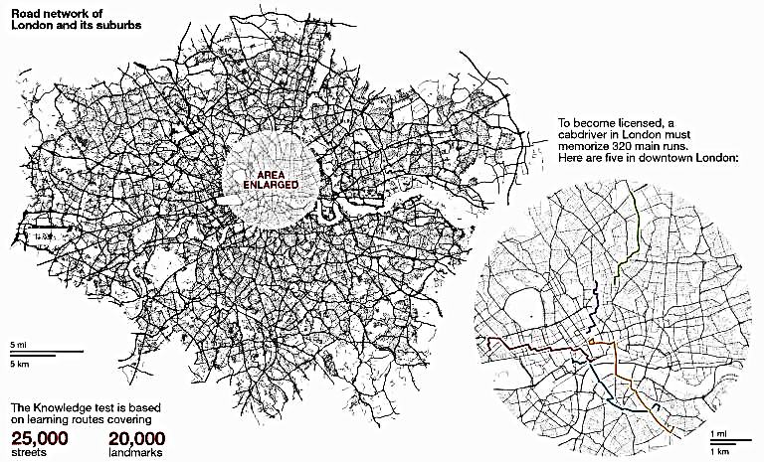
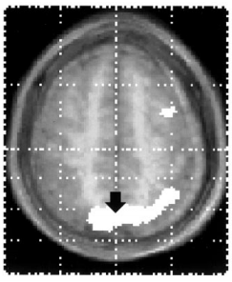
Learning and skill acquisition (cont’d)
The Journal of Neuroscience, September 15, 1997, 17(18):7103–7110
PET study on London taxicab drivers that have been trained for 3 years suggests that right hippocampus was critically involved in the recall of specific routs around London.
The relation between learning stage and hippocampus response has not been investigated yet, which may potentially shows the learning stage.

Slide 26
Conclusion
Neuro-ergonomics represents a deliberate merger of neuroscience and ergonomics with the goal of advancing understanding of brain function underlying human performance of complex, real-world tasks.
The basic enterprise of ergonomics- how humans design, interact with and use technology – can be considerably enriched if we also consider the human brain that makes such activities possible.

